Slide 1
Automatic Classifications of solos and kicks in gaelic football using accelerometer data
By Robert Dowd

Slide 2
Introduction
The objectives of this project are:
Identify potential durations and predictive characteristics of solos, kicks or shots.
Build a machine learning model using support vector machines and random forests that will classify Gaelic players solos, kicks or shots
Assess the quality of the models and compare them
Who could benefit from this project?
Football players or coaches can use this project to assess a player's possession of the ball, and the quantity of solos, kicks and shots completed throughout a training practice or game.

Slide 3
Literature Review
What did we learn from our literature review?
SVMs and Random Forests are effect machine learning algorithms for detecting kicks
Potential windows for player actions can be found using sliding windows, peak detection and the magnitude value of accelerometer data
Constructed predictor characteristics from these windows such as standard deviation, variance, max value, min value, interquartile range, skewness, and kurtosis.
Access models performance using sensitivity (recall) or precision
Sensitivity = TP / (TP + FN)
Precision = TP / (TP + FP)

Slide 4
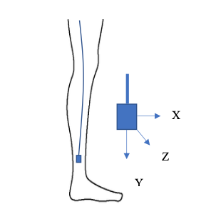
Data Collection and Cleaning
Accelerometer data using an accelerometer attached to 4 players legs when the player was running while soloing, kicking and taking shots at random for roughly 5 minutes each
Each accelerometer value represented 100th of a second
Convert accelerometer data to g-force. 9.8m/s/s = 1G.
When the accelerometer was stationary the gravitational influence was 82.
To covert our accelerometer to g-forces we divided the the data by 82.
Figure 1: Accelerometer placement on the players leg and axes orientation (Cust, 2020).
Cust, E.E. (2020) An Investigation into Kicking in Women’s Australian Football, thesis

Slide 5
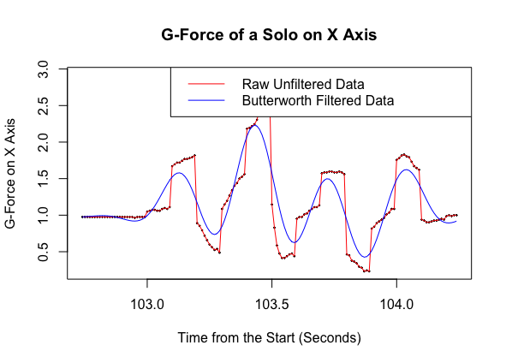
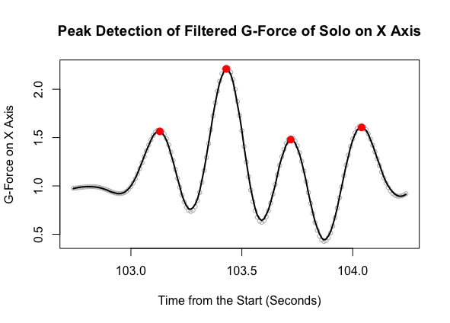
Exploratory Analysis
Applying Butterworth Filter improved the readability of our data
Explored 9 solos and 9 kicks taken when a player was standing and discovered:
Time for Solo = 1 to 1.25 seconds
Time for Kick = 1
Applied peak detection and discovered solos contain 4 unique peaks
Identified minimum magnitude values
Min Magnitude for Solo = 2G
Min Magnitude for Kick = 5G
Figure 2: G-Force of a Solo on X Axis showing the Raw Unfiltered Data and the Butterworth Filtered Data
Figure 3: Peak Detection on Butterworth Filtered G-Force of a Solo on X Axis

Slide 6
Feature Engineering
Constructed a sliding window over 1.5 second periods to gather potential windows
Algorithm for solo windows based on their characteristics
Magnitude Value over 1.5G (Min = 2G)
Contains more than 3 peaks
Remove duplicates windows with the same max value time.
Algorithm for kick windows based on their characteristics
Magnitude Value over 3.5G (Min = 5G)
Remove duplicates windows with the same max value time.

Slide 7
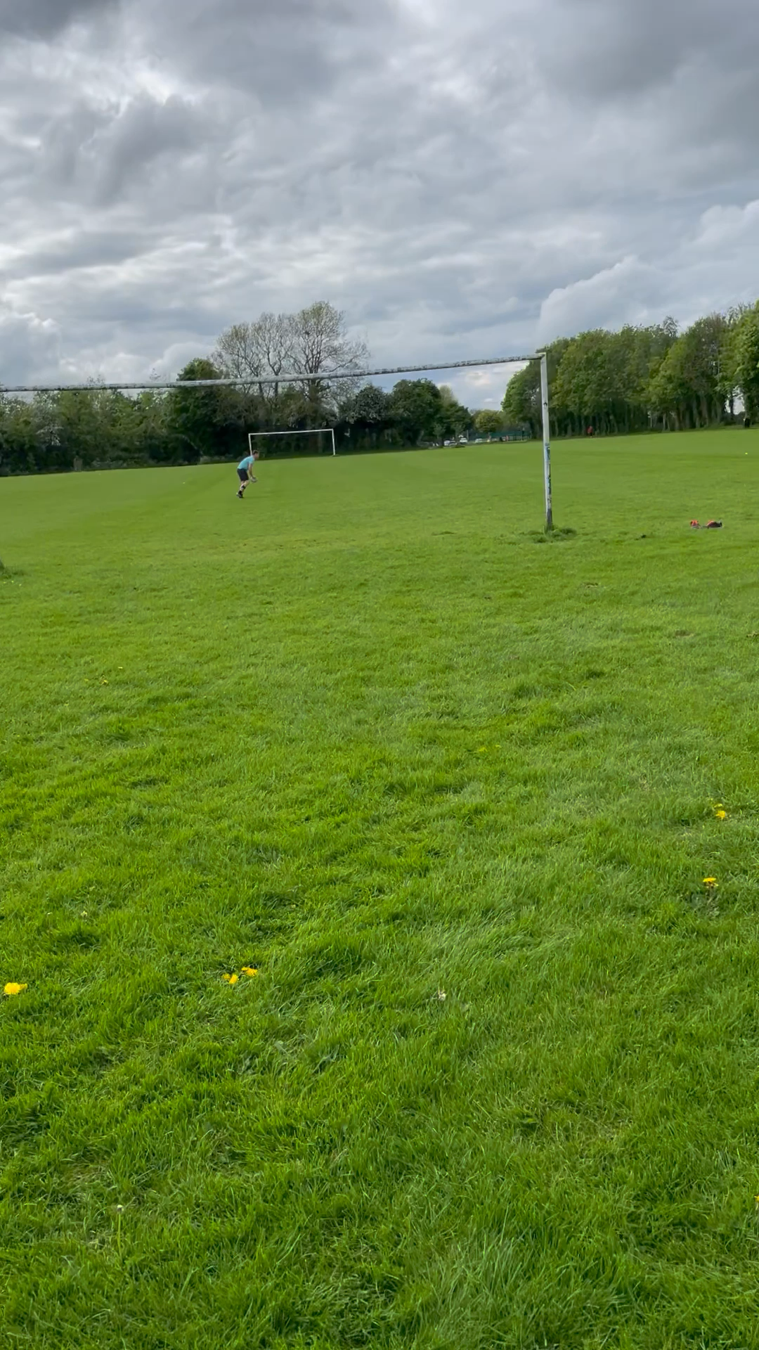
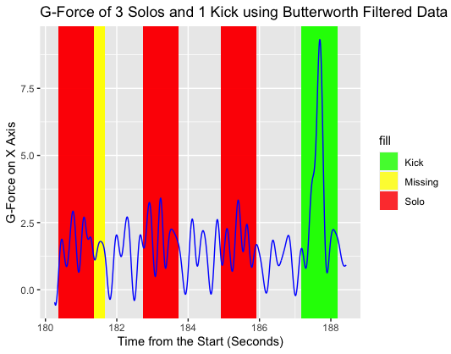
Feature Engineering
Manually label each window using recorded video footage
Constructed characteristic variables over a 1 second period for both solos and shots (explain with demo)
Characteristic variables are standard deviation, variance, max value, min value, interquartile range, skewness, and kurtosis
Figure 4: G-Force of 3 Solos and 1 Kick using Butterworth Filtered Data from Subject A.

Slide 8
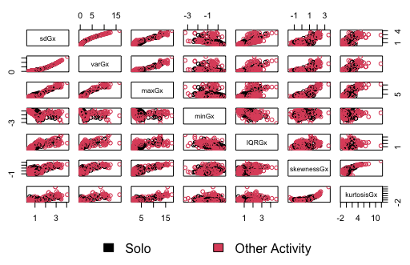
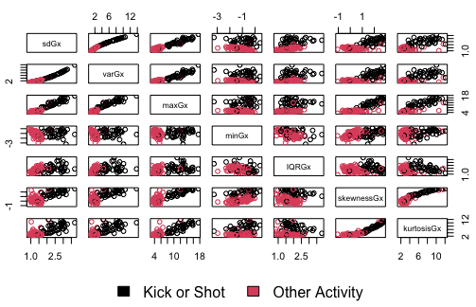
Predictive Modelling
Model Data
Random 70% Subject B, C and D (TRAIN) / Remaining 30% (TEST)
Subject B, C and D (TRAIN) / Subject A (TEST)
Solos are not linearly separable (SVM needs Kernel Trick)
Shots are linearly separable
Figure 8: Pairs Plots of Characteristic Variables for Solos for Subject B, C and D
Figure 9: Pairs Plots of Characteristic Variables for Kicks or Shots for Subject B, C and D

Slide 9
Predictive Modelling
Model Results
Figure 10: Model Results for Solos
Figure 11: Model Results for Kicks or Shots

Slide 10
Conclusion and recommendations
Both SVM and Random Forest Models can identify kicks in Gaelic football accurately
More detailed actions such as solos are more difficult to identify
Why?
The length of time for a solo can vary
Solos are similar to running
Future Research and Recommendations
Test with a larger sample size
Test over the period of a game (may find more false positives for solos)
Improve solo detection models with gyroscope data (successfully when identifying walking and running) (Miao et al., 2015)
Miao, F. et al. (2015) ‘Identifying typical physical activity on smartphone with varying positions and orientations’, BioMedical Engineering OnLine, 14(1). doi:10.1186/s12938-015-0026-4.

